Slide 1
Dataverse for Teams Administration
Module 6
Notes:
Workshop Version: 1.4

Slide 2

Module overview
This module covers the following topics:
 | 1 | Teams Apps administration
 | 2 | Dataverse for Teams environments
 | 3 | Dataverse for Teams data security
 | 4 | Reporting and analytics on app usage

Slide 3



Backend administrators’ capabilities
Management of apps available to your organization (or individual users)
Highlighting the apps that your organization should use
View analytics and reports on usage of apps within organization
Management of Dataverse for Teams environments
Implementing security and compliance features of Microsoft 365

Slide 4
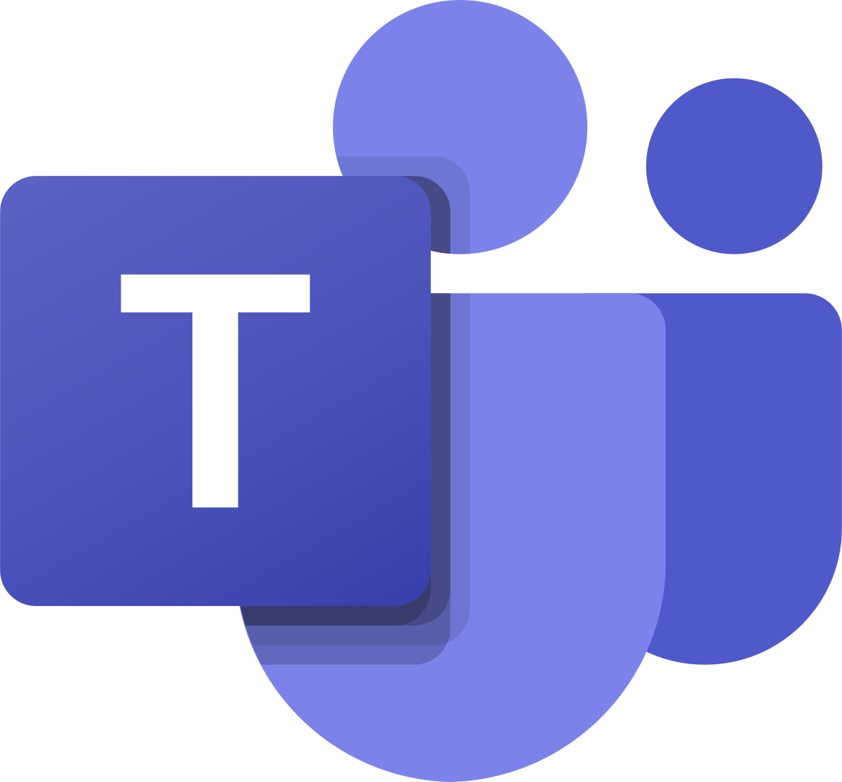

Dataverse for Teams Administration
There are two main interfaces for administration relevant to Dataverse for Teams:
 | Teams Admin Center: https://admin.teams.microsoft.com/ Available to: Global and Teams Service Administrators
 | Power Platform Admin Center: https://aka.ms/ppac Available to: Global, Power Platform and Dynamics 365 Administrators
Microsoft Confidential

Slide 5
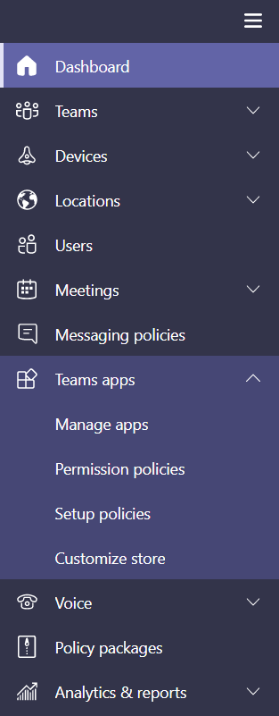
Teams Admin Center Controls
There are 3 main configuration areas relevant to apps within Teams that can be utilized by admins in the Teams admin center:
Manage apps
What apps are available within the organization
Permission policies
What apps are available for different sets of users
Setup policies
How apps are made available to users in the Teams client
Microsoft Confidential
Notes:
The Teams admin center allows admins to manage the apps that are available to the organization through permissions policies – for example, I can allow users to install all apps, no apps, or anything in between on an app-by-app level

Slide 6
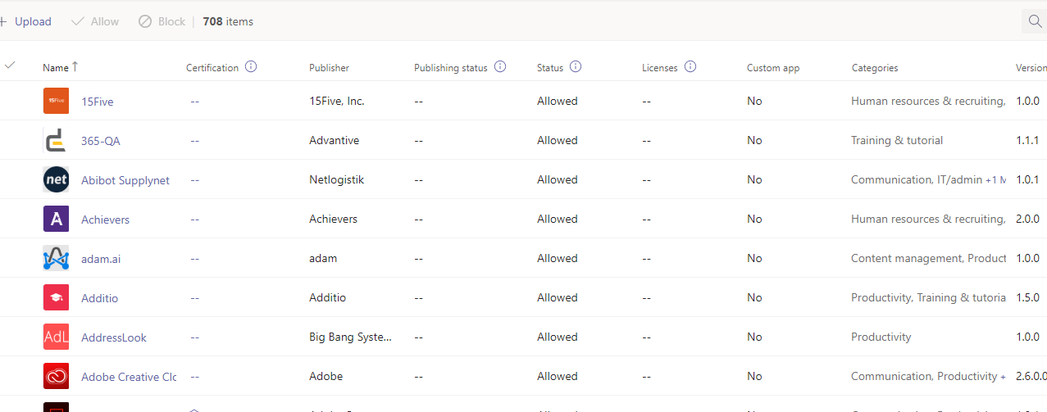
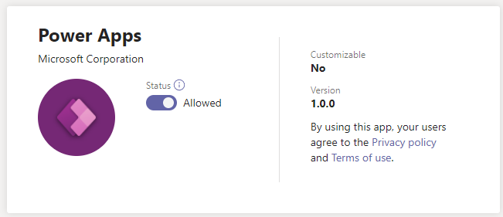
Manage Apps
App catalog is a list of all apps available in the tenant, including apps required for Dataverse for Teams
The apps developed using Dataverse for Teams will appear in the catalog, too
An admin can set the global status of each app to Allowed or Blocked
Microsoft Confidential
Notes:
The catalog includes apps from Microsoft, 3rd party, and internally developed (custom apps)
Admins can view the details for each app, including publisher, certification and version
You can allow or block individual Apps at the org level using the Manage Apps page. When you block an app, all interactions with that app are disabled and the app doesn't appear in Teams for any users in your organization​
Global or Teams admins can use Teams app controls through Teams admin center to enable/disable apps relevant to Dataverse for Teams.
This will affect all users in the organization!

Slide 7
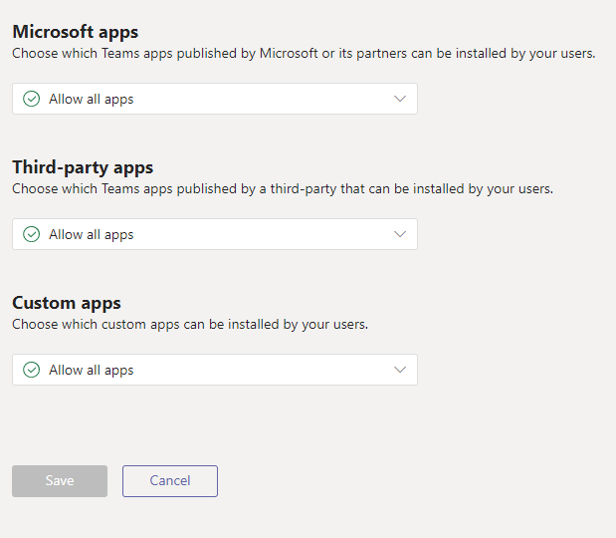
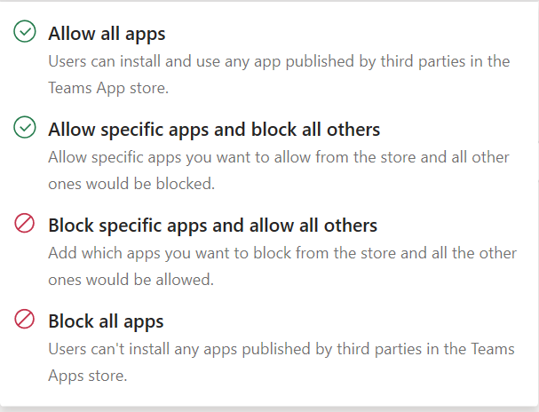
App Permission Policies
The app permission policies allow granular control over what apps can be used by different users and groups within the organization
Each policy dictates what apps should be allowed from each group:
Microsoft
3rd party
Custom
Microsoft Confidential
Notes:
There are very few reasons to not allow all Microsoft apps since they are integrating Office 365 applications which have the same data-handling, security, and compliance standards as Microsoft Teams.
Note: Some Microsoft apps are considered 3rd party (Who, App Studio)
We recommend that customers should allow third party and custom apps in org-wide app settings. If administrators want to block apps this should be done with permission policies.
The app permission policies can be used to enable/disable apps relevant to Dataverse for Teams for selected users or groups only.
An app permission policy can be assigned to specific users or groups; if a user is not subject to any custom policy, the default Global policy will apply

Slide 8
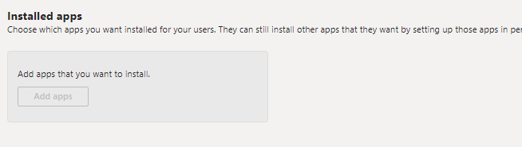
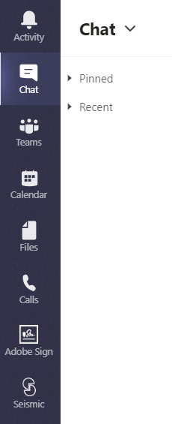
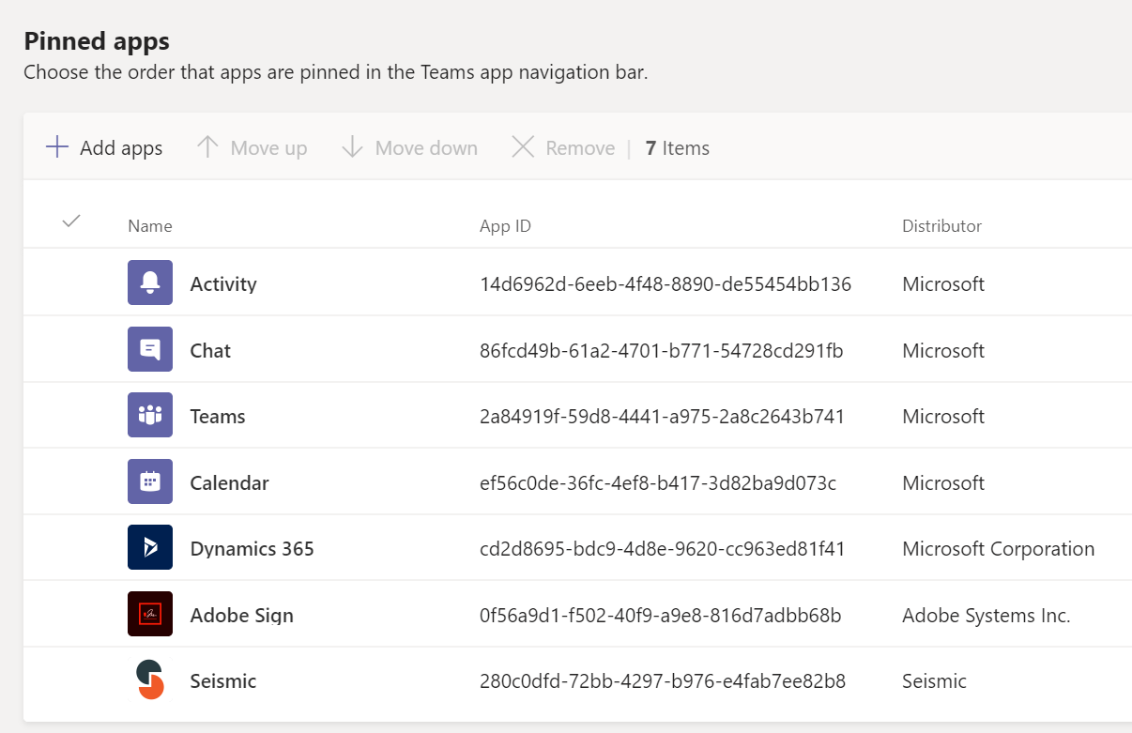
Setup Policies
The setup policies can be used to push apps to users’ Teams client.
The admins can:
Install apps on behalf of users
Pin apps to the left panel of the Teams client
Microsoft Confidential
Notes:
This allows pushing apps (developed using Dataverse for Teams, or the Power Apps and Power Automate apps for the makers), and making them more visible
A setup policy can be assigned to specific users or groups; if a user is not subject to any custom policy, the default Global policy will apply

Slide 9



Dataverse for Teams Environment Limits per Tenant
Dataverse for Teams environments are calculated as 5 + 1 per 20 eligible Microsoft seats
Maximum data storage within a single Dataverse for Teams environment is 2 GB or 1 million rows
This storage limit can't be extended further – consider upgrading to full Dataverse if that is required
Microsoft 365 Tenant
Environment 1
Environment 2
2GB
...
Environment N
2GB
2GB
Up to max 19.5 TB total Dataverse for Teams capacity
Notes:
The number of available environments are 5 + 1 per 20 eligible Microsoft 365 seats. Customers with more than 200,000 eligible licenses can talk to their MS Representative to get over 10000 limit.
Each Dataverse for Teams environment provides 2 GB of combined database, file storage, and system use or 1 mln rows (whatever comes first).
Should more storage be needed, consider upgrading environments to Dataverse
Max Dataverse for Teams environment storage per tenant10 GB + Dataverse for Teams environments × 2 GB (up to a maximum of 19.5 TB). The 2 GB storage limit can't be extended further. Should more storage be needed, consider upgrading environments to Dataverse.

Slide 10
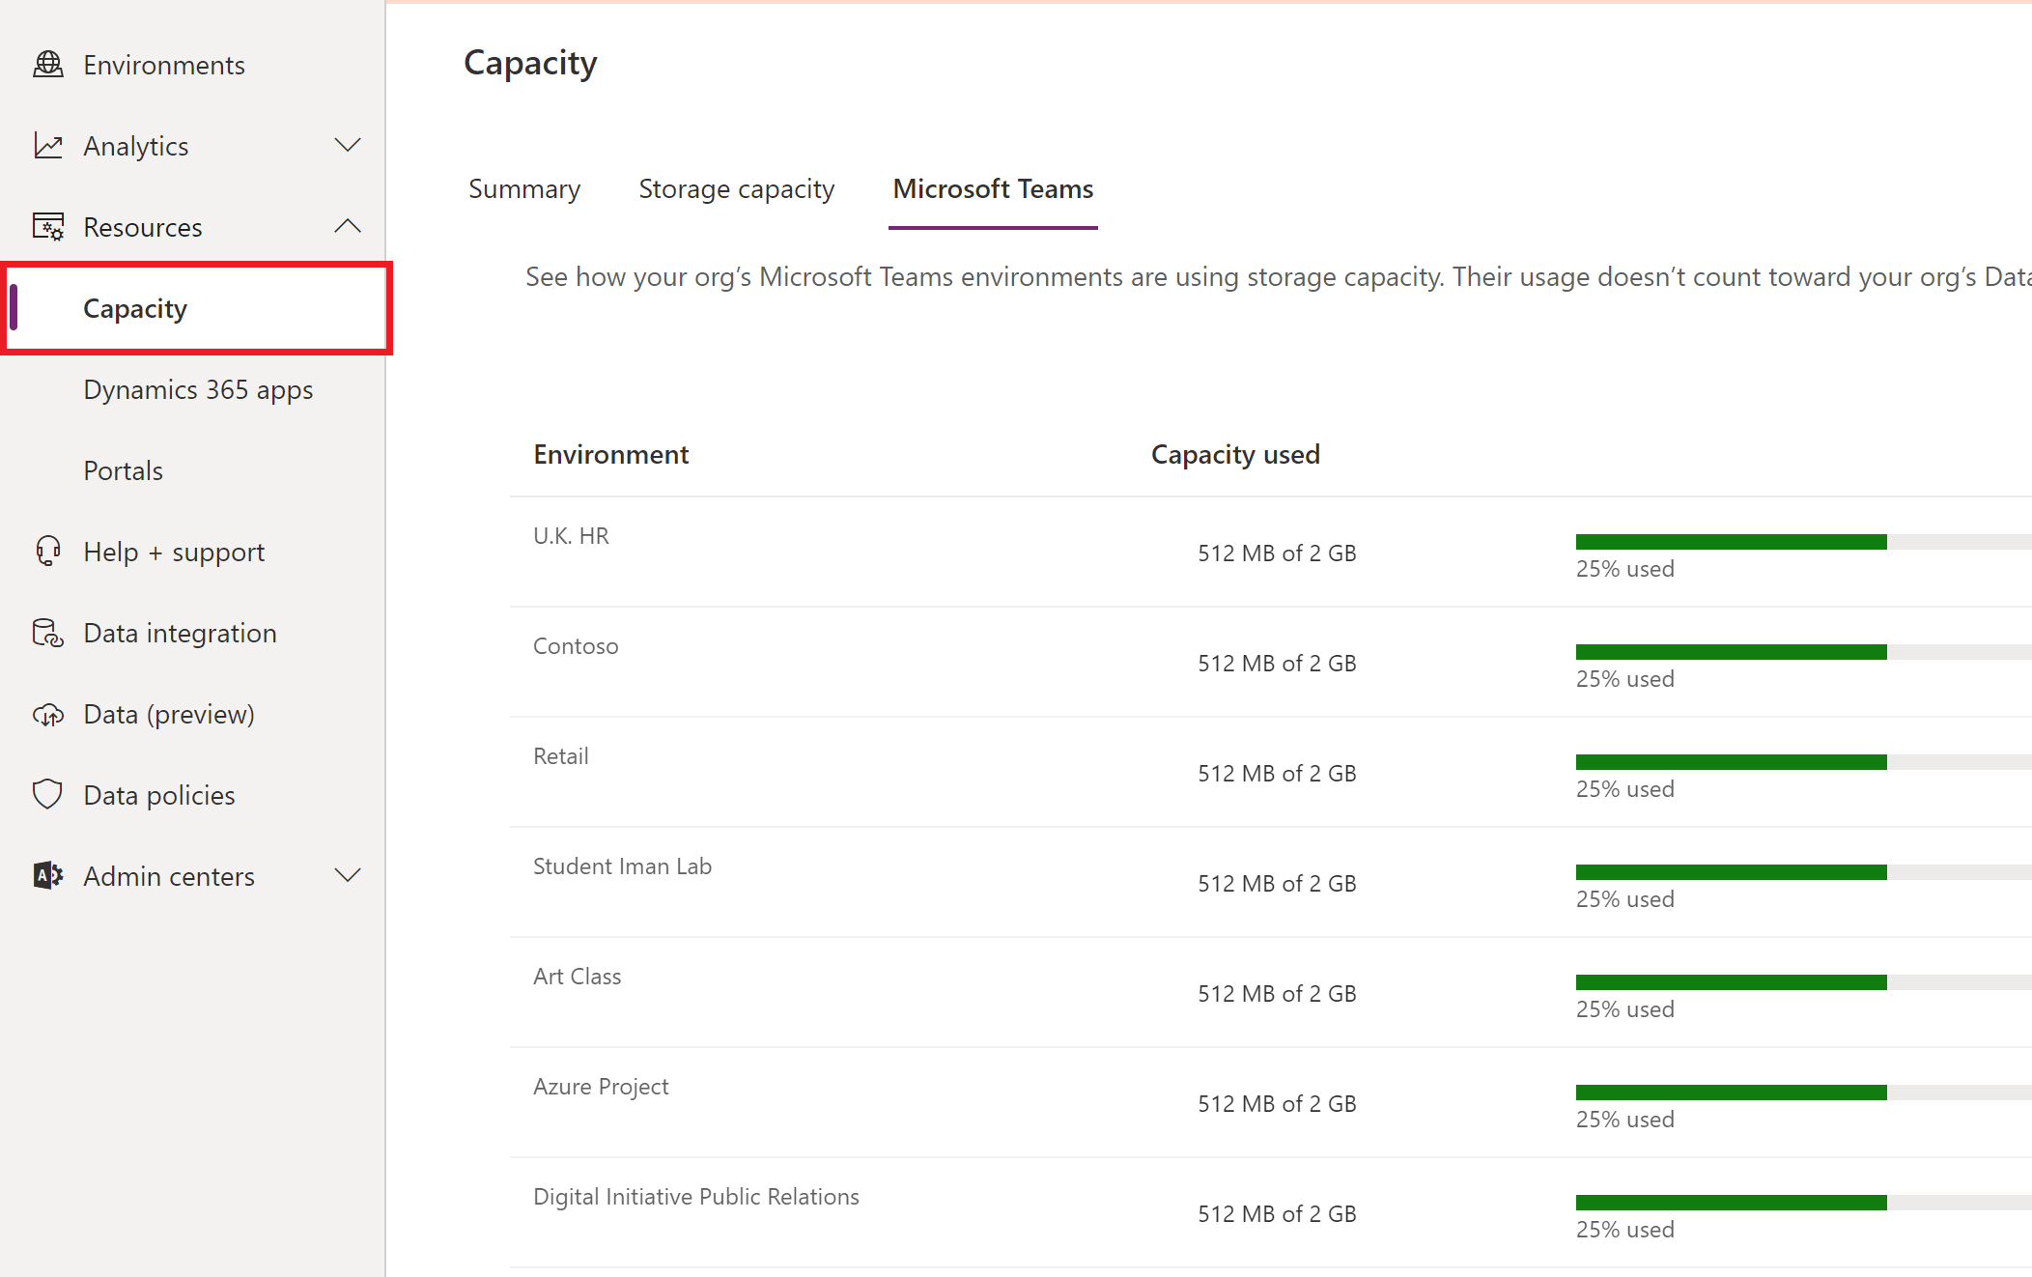
Dataverse in Teams Storage Constraints
If an environment exceeds 2 GB:
At 80% of the limit the users will be notified that capacity is almost over
At 100% new apps, bots, flows, and tables can't be created or installed. Any existing apps, chatbots, and flows will continue to work and existing apps can be updated
Microsoft Confidential
Notes:
The notification will be visible in the Microsoft Teams maker experience informing them the capacity limit is about to be reached.
At this point, customers are encouraged to either reduce storage usage or contact their admin for other options.
The administrators can view the overall capacity information in PP admin center.
The consumption of capacity by Dataverse for Teams environments won't count towards the tenant's capacity limits. Instead, we'll provide a pool of capacity for Dataverse for Teams environments, which will be separate from the tenant's Microsoft Power Platform Dataverse capacity pool. Capacity won't be transferable between these two pools.
Per-environment limits on Dataverse for Teams environments: Each Dataverse for Teams environment provides 2 GB of combined database and file storage, with a portion of this amount reserved for system use. To see the consumption of each Dataverse for Teams environment in a tenant, go to the Power Platform admin center (https://aka.ms/ppac), then to Resources > Capacity > Microsoft Teams Capacity.

Slide 11
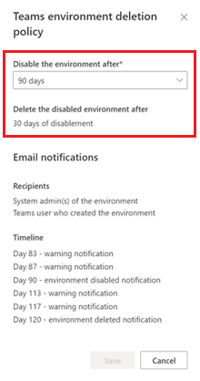
Automatic deletion of inactive environments
Administrators can set the Teams environment deletion policy
Dataverse for Teams environments that are considered inactive are first disabled
They're deleted after a period if no action is taken by the administrators
PPAC > Policies > Environment Policies
Microsoft Confidential
Notes:
See: Automatic deletion of inactive Microsoft Dataverse for Teams environments - Power Platform | Microsoft Docs

Slide 12
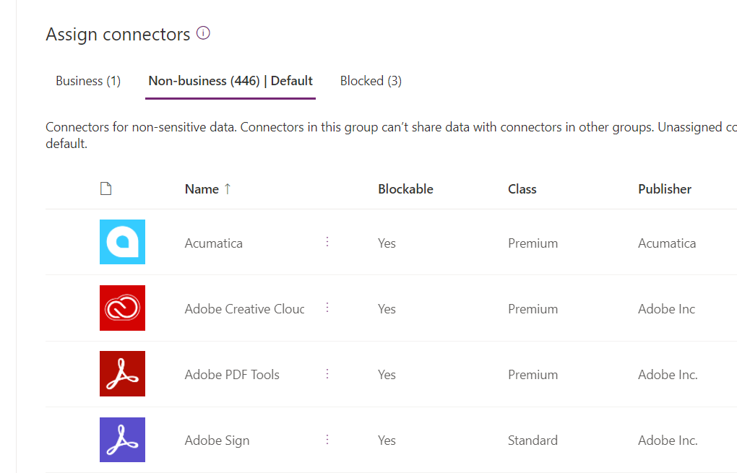
Data Loss Prevention (DLP) Policies
Tenant admins can use data loss prevention (DLP) policies to configure what connectors can be used together
Connectors can be grouped into “Business” and “Non-business” categories
Only connectors from the same group can be used in an app or flow
Non-Microsoft connectors can also be fully blocked
Notes:
Power Apps lets you create and enforce data loss prevention (DLP) policies that define which connectors specific business data can be shared with. For example, an organization that uses Power Apps may not want its business data that's stored in Dataverse for Teams to be automatically published to its Twitter feed.
To create, edit, or delete DLP policies, you must have either Environment Admin or Azure Active Directory Tenant Admin permissions.
Tenant admins can define policies that apply to all or selected environments

Slide 13
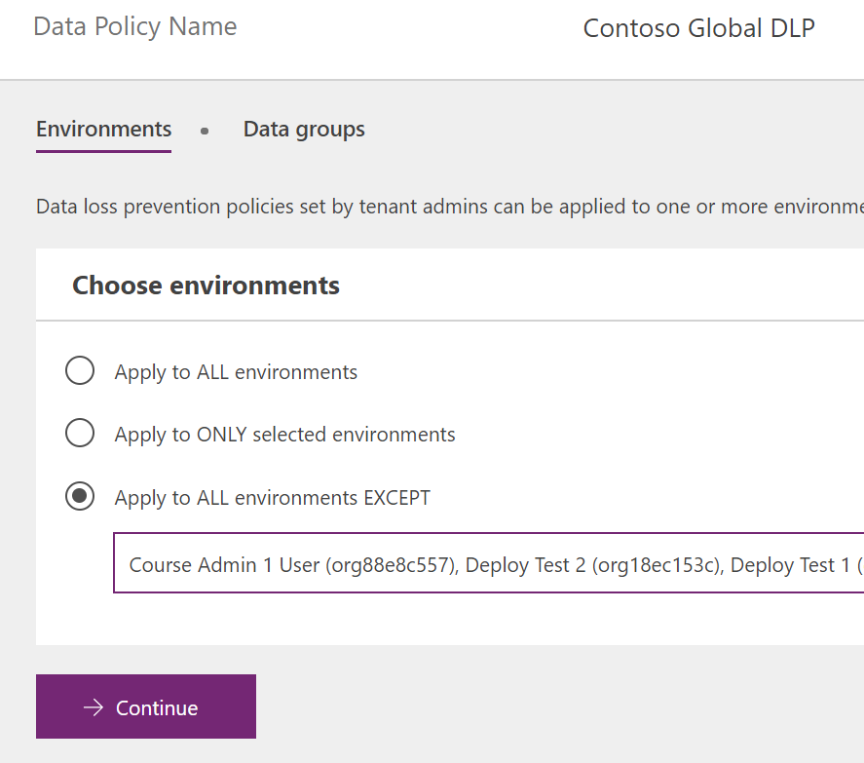
Applying DLP policies to environments
Multiple policies can be applied to an environment
The most restrictive policy applies to the combination of connectors
Use ONLY and EXCEPT to tailor which environments are impacted
Notes:
Your DLP policies should be customized for each environment you create. The policies should match the unique needs and requirements for the environment.

Slide 14
Microsoft Approach to Security
Power Apps and Power Automate do not elevate privilege: users only work with data that they already have access to
Security and compliance need to be enforced on every level for maximum protection of organizational data
Microsoft 365 provides tools for data protection and governance on multiple levels
Identity
Infrastructure
Microsoft 365
Devices
Apps & Data
Microsoft Confidential
Notes:
Identity— Help protect against identity compromise and identify potential breaches before they cause damage
Devices—Enhance device security while enabling mobile work and BYOD
Apps and Data—Use the built in Security and Compliance tools within M365 apps, as well as controls applicable to individual items, e.g. Microsoft Information Protection; while certain features do not interact with Dataverse for Teams directly, they are available to content that DfT solutions may interact with, e.g. items stored on SharePoint or OneDrive.
Infrastructure—Apply protection measures to different M365 workloads

Slide 15
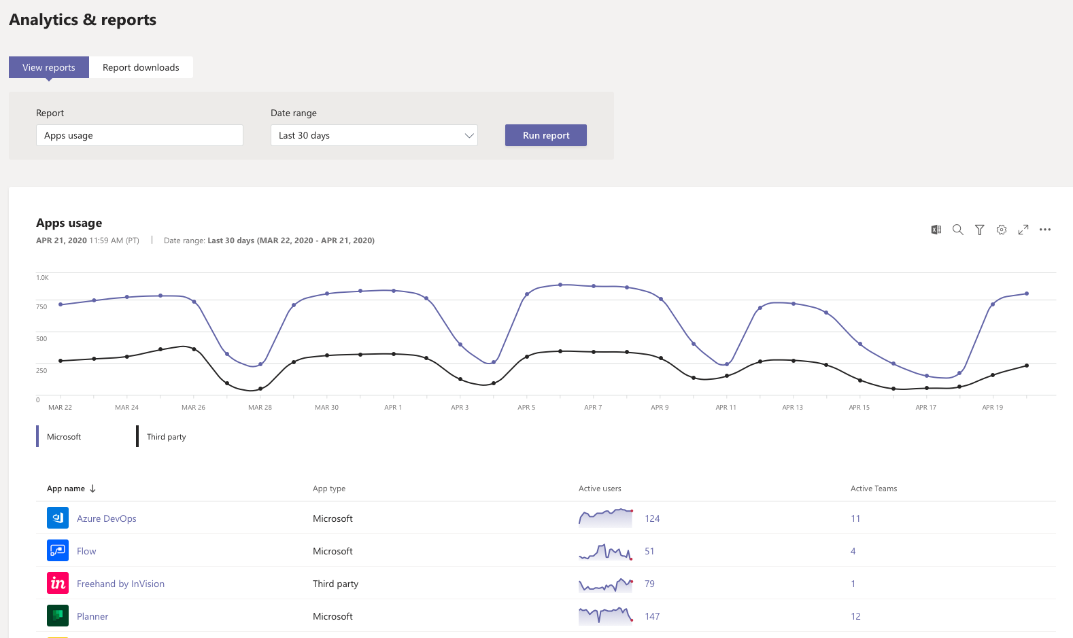
Teams Apps Analytics and Reporting
Apps usage reports can be viewed from the Teams admin center and can show how many users and teams are utilizing each app
Available timeframes:
7 days
30 days
90 days
Microsoft Confidential
Notes:
The analytics for Dataverse for Teams apps can be obtained from here by the Teams admins

Slide 16
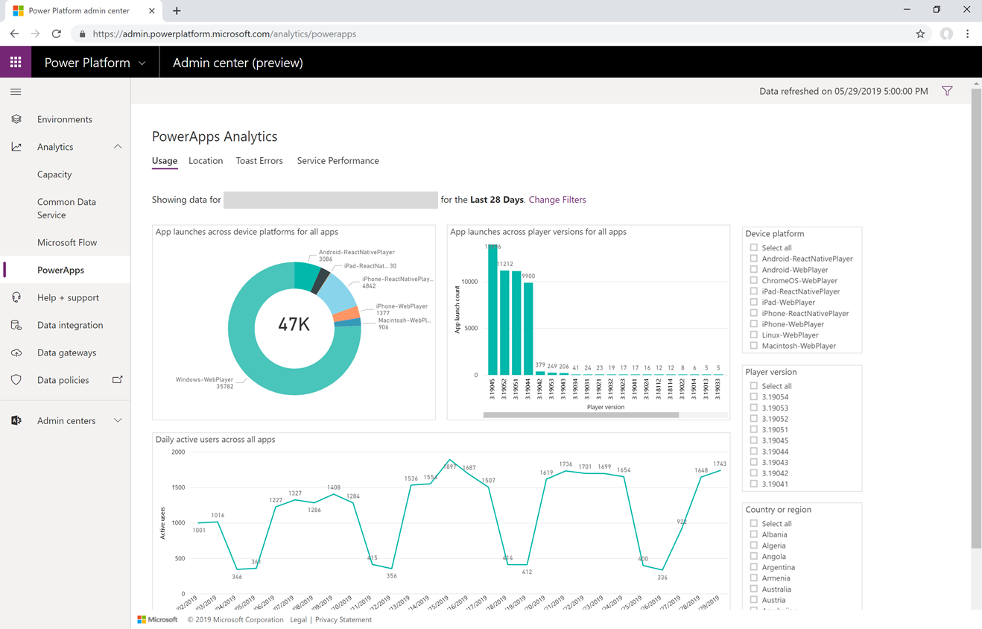
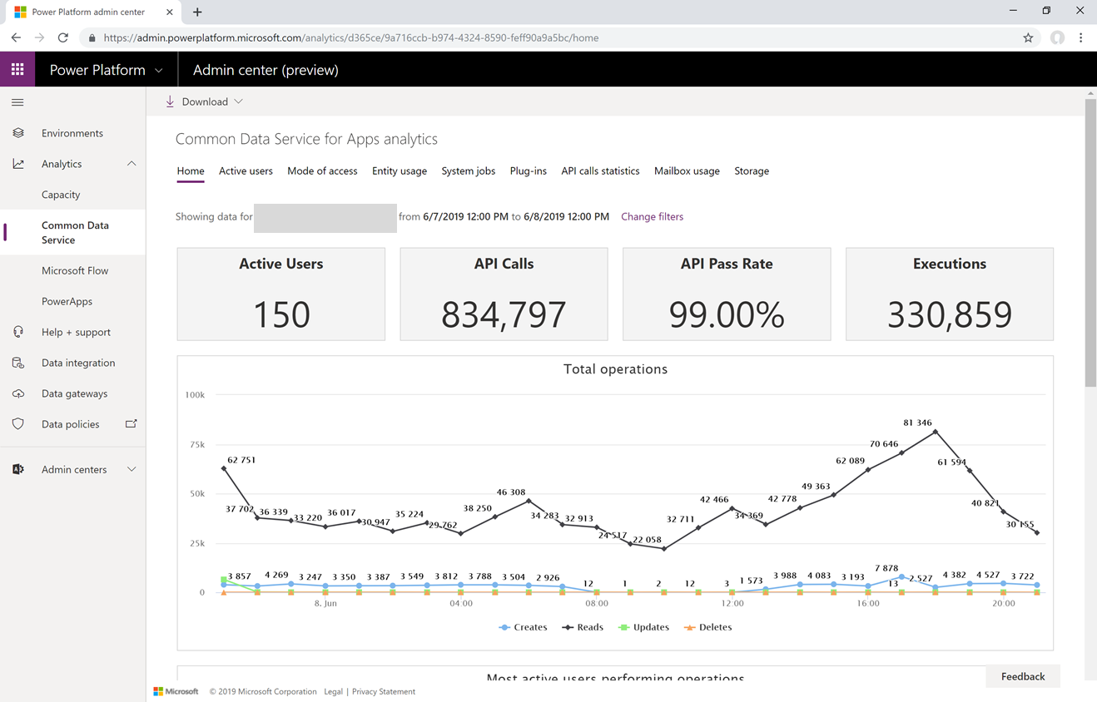
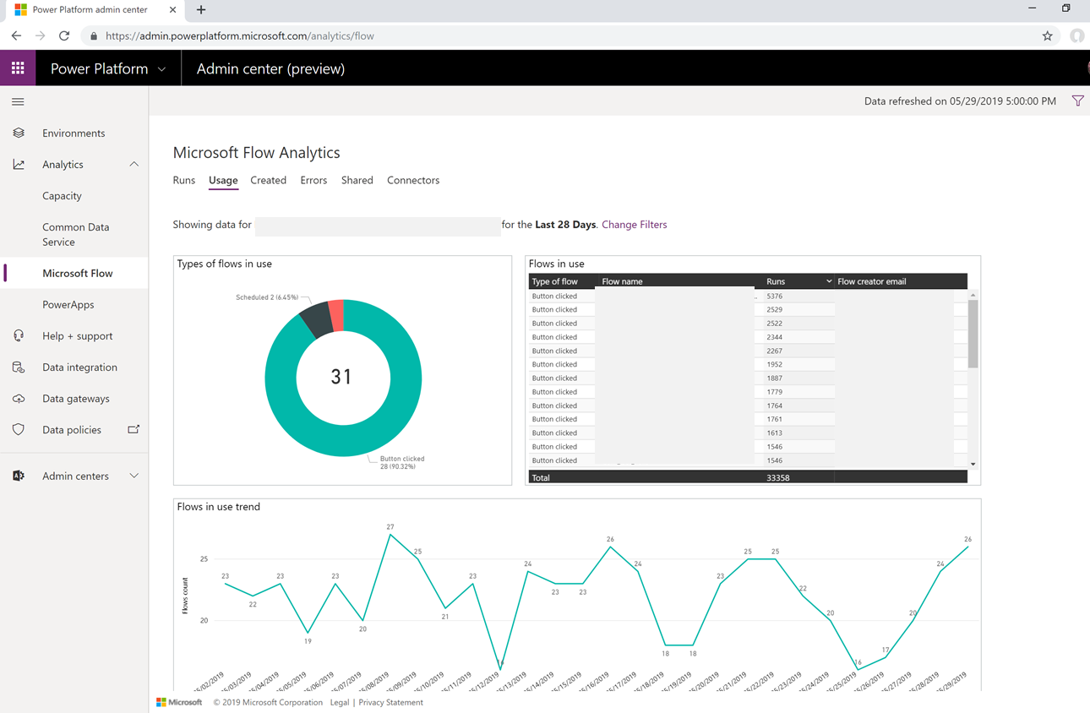
Power Platform Admin Center Reporting
Power Apps analytics
Dataverse analytics
Power Automate analytics
Information including most active users, most popular solutions, usage statistics, storage consumption and other types of insights across these workloads
Notes:
The statistics about larger dataverse, individual Power Apps and Power Automate flows (that could be part of a Dataverse for Teams based app) can be obtained from here by Power Platform admins

Slide 17
Appendix

Slide 18
Apps Relevant to Dataverse for Teams
Global or Teams admins can use Teams app controls through Teams admin center to enable/disable apps relevant to Dataverse for Teams.
TEAMS App name | Controls
Power Apps | Ability to use Dataverse or Dataverse for Teams apps within Teams, create new Power Apps using Teams and create new Dataverse for Teams environments
Power Virtual Agents | Ability to use Dataverse or Dataverse for Teams Power Virtual Agents within Teams, create new Power Virtual Agents using Teams, and create new Dataverse for Teams environments
Shared Power Apps | Ability to use Dataverse or Dataverse for Teams Power Apps within Teams using ”Built by your colleagues” catalog
Shared Power Virtual Agents | Ability to use Dataverse or Dataverse for Teams Power Virtual Agents within Teams using ”Built by your colleagues” catalog
Sample Apps (e.g. Employee Ideas) | Ability to create new Power Apps, Power Automate, and Power Virtual Agents by using specific sample apps within Teams
Microsoft Confidential
Notes:
To demonstrate, open Teams admin center -> Manage Apps -> Search -> “Power”
https://docs.microsoft.com/en-us/powerapps/teams/use-sample-apps-from-teams-store

Slide 19
Key Limitations of Dataverse for Teams
Additional components such as Model-driven apps, AI Builder, Component library are not available
Not available in these regions: South Korea, GCC, GCC High
Not all controls are supported
Localization of Power Apps studio is not available
Microsoft Confidential
Notes:
GCC is US government : Government Community Cloud
Dataverse for Teams will be available as part of select Microsoft 365 subscriptions with Microsoft Power Platform and Microsoft Teams capabilities, excluding plans for US government environments (GCC, GCC High and DoD) and EDU A1 and SUB SKUs.
About the Microsoft Dataverse for Teams environment - Power Platform | Microsoft Docs
Known issues and limitations for Dataverse for Teams - Power Apps | Microsoft Docs

Slide 20
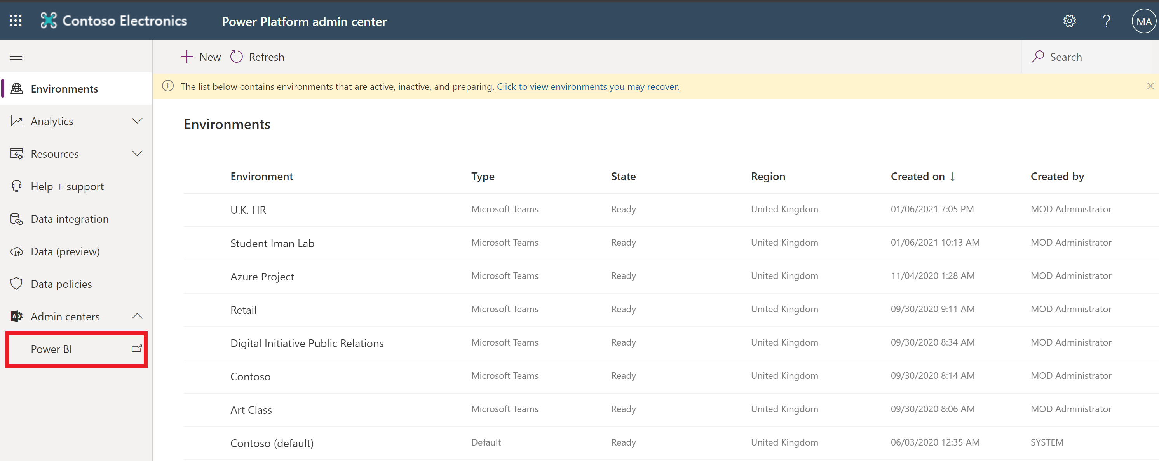
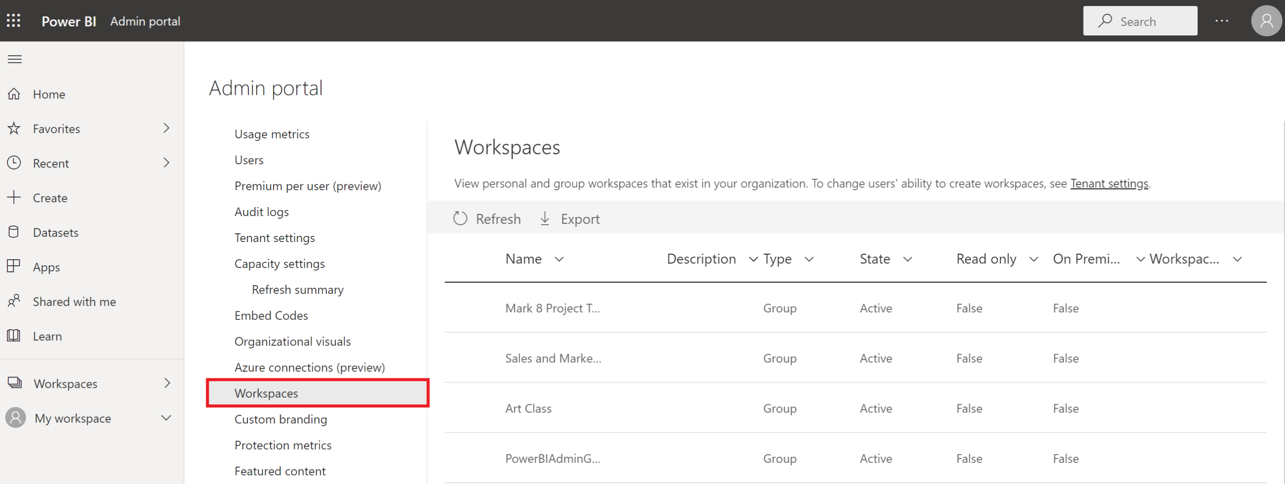
Reporting on Environments
With Power BI reporting you can obtain a report on all environments within your tenant
Microsoft Confidential
Notes:
About the Microsoft Dataverse for Teams environment - Power Platform | Microsoft Docs
To access Power Platform Admin Centre: https://admin.powerplatform.microsoft.com
To Check Power BI admin Portal: https://app.powerbi.com/admin-portal

Slide 21
Dataverse for Teams vs Dataverse: Tables
Features | Dataverse for Teams | Dataverse
Targeted scenarios | Teams Productivity | Enterprise productivity
Non-relational storage (logs) | No | Yes
Managed data lake | No | Yes
Advanced and relevance search | No | Yes
Mobile offline | No | Yes
Advanced data types | No | Yes
Common Data Model | Coming Soon | Yes
Notes:
Examples of Advanced data types: customer, multiple transaction currencies
For more details always check https://docs.microsoft.com/en-us/powerapps/teams/data-platform-compare
Dataverse for Teams vs. Dataverse - Power Apps | Microsoft Docs

Slide 22
Dataverse for Teams vs Dataverse: BI and developer features
Features | Dataverse for Teams | Dataverse
Paginated reports (SQL Server Reporting Services) | No | Yes
API Access | No | Yes
Plugins | No | Yes
Notes:
Dataverse for Teams vs. Dataverse – Power Apps | Microsoft Docs
Paginated reports – SQL server reporting

Slide 23
Dataverse for Teams vs Dataverse: Environments
Features | Dataverse for Teams | Dataverse
Number of environments | 1 per Team | Unlimited
Maximum size | 1 million rows or 2 GB (whichever comes first) | 4 TB or more

Slide 24
Dataverse for Teams vs Dataverse: Security
Features | Dataverse for Teams | Dataverse
Activity logging | No | Yes
Auditing | No | Yes
Customer-managed environment encryption key | No | Yes
Field-level security | No | Yes
Hierarchical security | No | Yes
Record sharing | No | Yes
Admin roles | System Administrator and System Customizer | As in DfT + additional service admin roles
User roles | Team owners, members, and guests | Several standard security roles + custom roles can be created
Notes:
More information: Use service admin roles to manage your tenant
More information: Security roles and privileges

Slide 25
Dataverse for Teams vs Dataverse: Integration
Integration Features | Dataverse for Teams | Dataverse
Export to Azure data lake | No | Yes
Data Export Service | No | Yes
Events to Azure Event Hubs | No | Yes
Events to Azure Service Bus | No | Yes
Webhooks | No | Yes
Server-side sync | No | Yes
SQL Server Management Studio | No | Yes

Slide 26
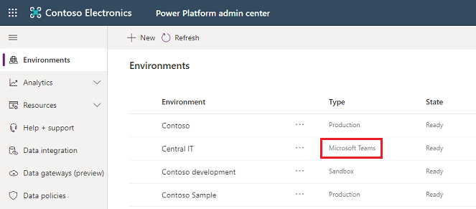
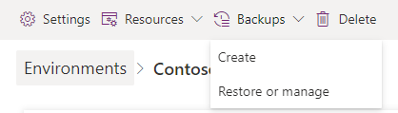
Management of Dataverse for Teams environments
Dataverse for Teams environment’s name is the same as the Team’s name, and its type will show “Microsoft Teams”
Dataverse for Teams environments can be Backed up, Restored and Deleted from the Power Platform admin center
Microsoft Confidential
Notes:
To access Power Platform admin center : https://admin.powerplatform.microsoft.com/environments
Discuss the current available environment lifecycle Backup, restore and delete. This URL shows the operation vs Availability in GA https://docs.microsoft.com/en-us/power-platform/admin/about-teams-environment#environment-lifecycle

Slide 27
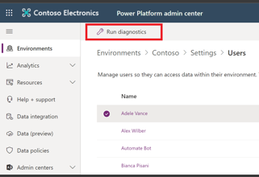
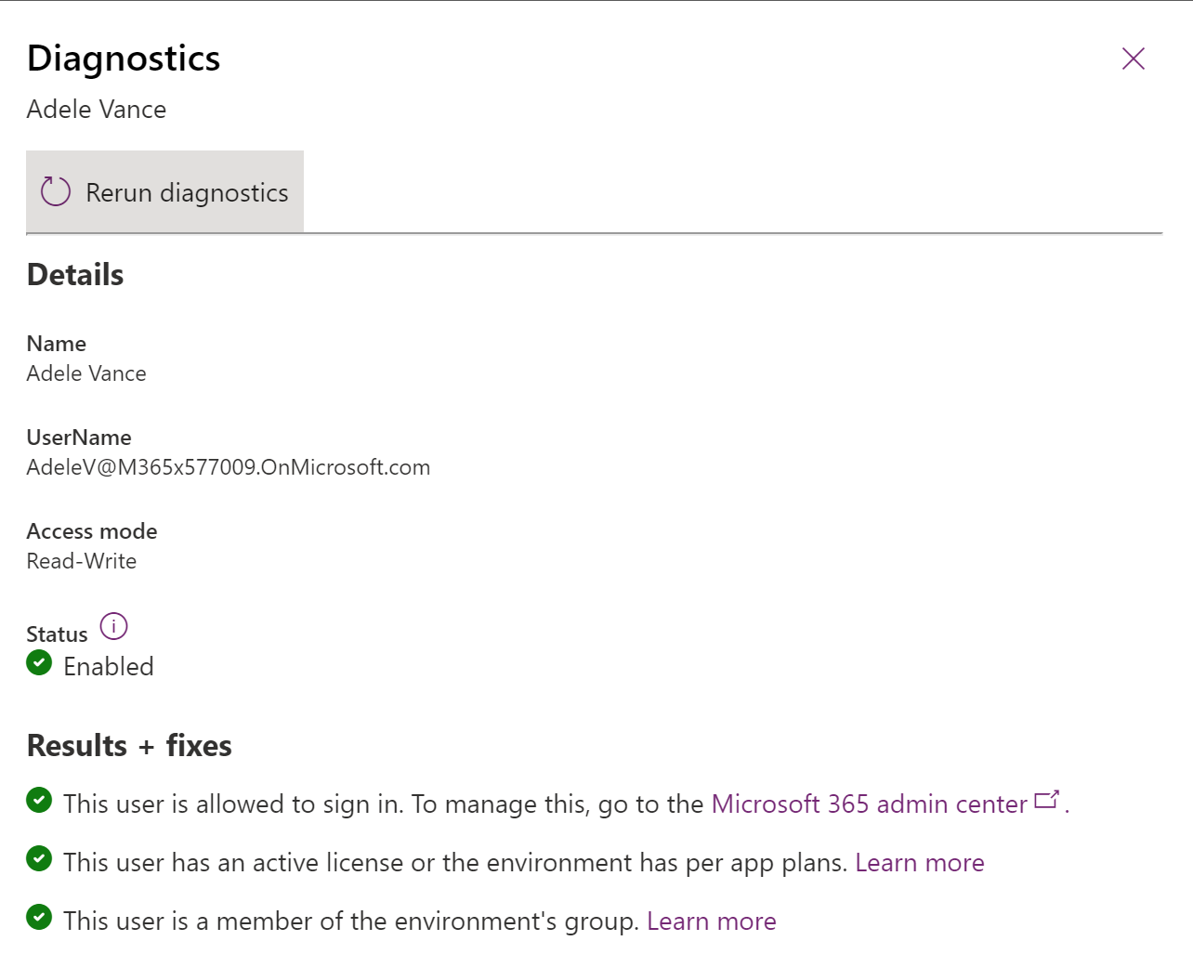
Users Permission – Run Diagnostics
Run diagnostics to check the user status:
Is this user Allowed to sign in?
Does this user have an active license?
Is this a member of the environment’s group?
Microsoft Confidential
Notes:
Create users and assign security roles - Power Platform | Microsoft Docs

Slide 28
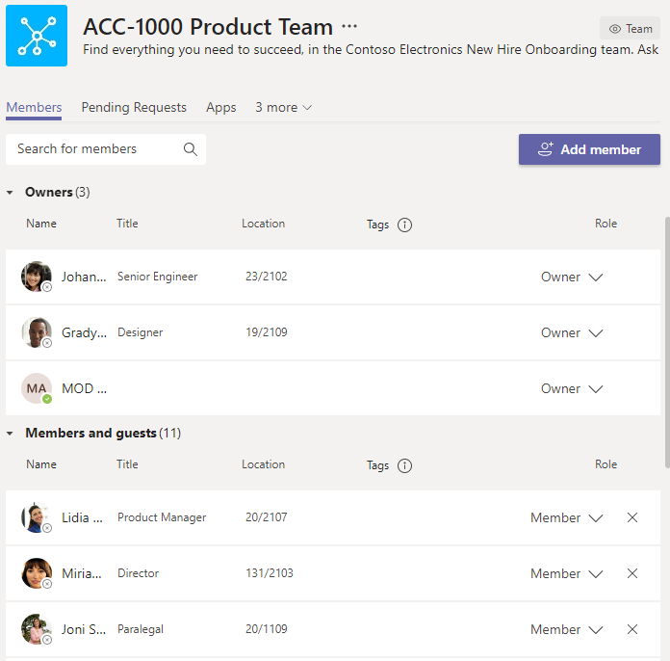



Permissions within Dataverse for Teams environment
Dataverse for Teams permissions align with the roles in the Team: Owners, Members, and Guests
Access to the data, and its management, are restricted to the Team’s owners, members and guests by default
Administrators do not have direct access to data within the environment
Microsoft Confidential
Notes:
The main point here is that the data within Dataverse for Teams can only be accessed by the people within the team, and the ones that the app was shared with, admins do not have access

Slide 29
Microsoft 365 Unified Audit Log
Activity logging integrated with Office Security and Compliance Center for comprehensive logging across Microsoft services
The audit records are stored in Office 365 Security and Compliance Center
Power Automate | Power Apps
Created flow Edited flow Deleted flow Edited permissions Deleted permissions Started a paid trial Renewed a paid trial | Created app Edited/save app (draft) Published app Deleted app Restored an app from app version Launched app Marking app as featured Marking app as hero Edited app permissions Deleted app permissions
Microsoft Confidential
Notes:
These actions in Audit log are related to Power Automate and Power Apps specific activities.
Activities happening in DfT specifically (e.g. editing information in the tables) are not logged.

Slide 30
Azure API Management in Dataverse for Teams
Azure API Management enables professional developers to publish their backend service as APIs
Those APIs can then be exported to the Power Platform (Power Apps and Power Automate) as custom connectors for consumption by citizen developers
Microsoft Confidential
Notes:
Citizen developers using the Microsoft Power Platform often needs to reach the business capabilities that are developed by professional developers and deployed in Azure – with APIM this can be achieved
https://powerapps.microsoft.com/en-us/blog/reshape-the-future-of-work-with-microsoft-dataverse-for-teams-now-generally-available/
https://docs.microsoft.com/en-us/azure/api-management/export-api-power-platform

Slide 31
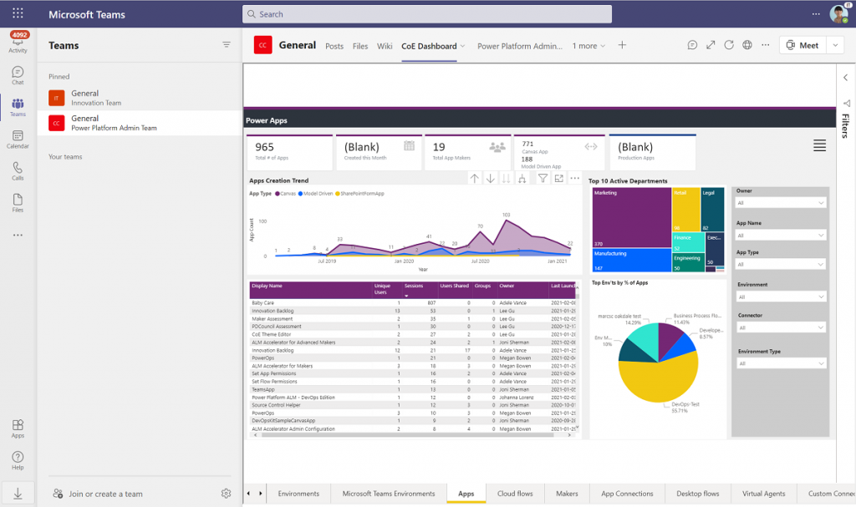
Center of Excellence Starter Kit for Dataverse for Teams
We brought CoE starts kits to Teams itself to help monitor Dataverse for Teams environments from within Teams
You can monitor how adoption is growing or check which apps or makers are using which connectors, and which makers are most active within your environments without having to leave the Teams context
Microsoft Confidential
Notes:
The CoE Starter Kit can now be installed in Dataverse for Teams environments. You can now make the Admin, Governance and Nurture templates in the kit a core part of your collaboration with admins, makers and end users in Teams.
Use the rich set of filters to see which apps or makers are using which connectors, and which makers are most active.
Now available: CoE Starter Kit in Dataverse for Teams (and other improvements) | Microsoft Power Apps
https://powerapps.microsoft.com/en-us/blog/now-available-coe-starter-kit-in-dataverse-for-teams-and-other-improvements/

Slide 32
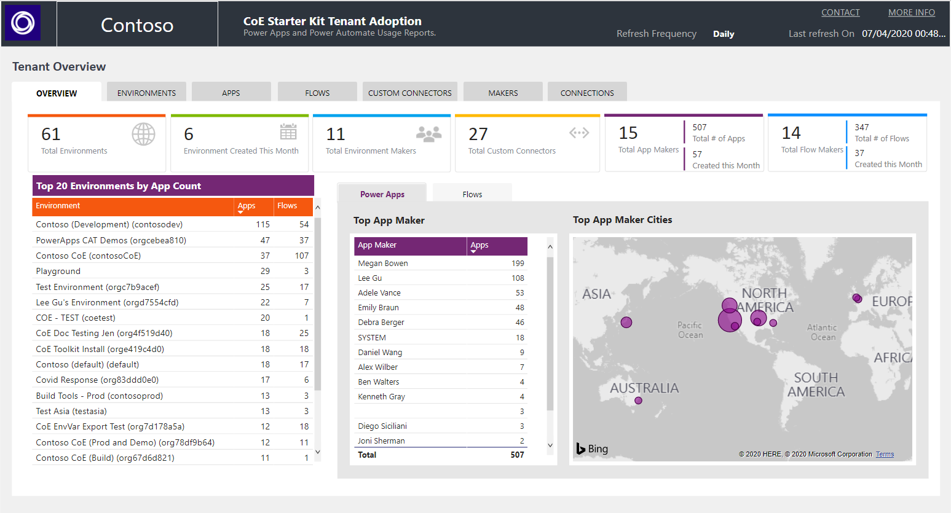
Center of Excellence Starter Kit
A community project endorsed by Microsoft, that can help get started with adopting and supporting the Power Platform
Provides a collection of components for admins, makers, designers and end users
Includes tools for reporting, audit, compliance, branding, onboarding of new users and much more
Microsoft Confidential
Notes:
Beyond those tools is a Center of Excellence starter kit, maintained by the Power CAT team and represents what we’ve learned from some of the largest organizations implementing Power Platform. However, this is not a checkbox exercise. This tool, built in Power Platform, is intended to be just that: a starter kit for technology to enable your processes. It can help with the how, once you’ve established the what and why.
Some of the data and foundation you’ll likely need is in here, but your organization will undoubtedly want to tailor this for its own use. As you do, we would love to incorporate your innovations back into the tool. I’ll be showing the Center of Excellence start kit throughout the presentation today too.
https://docs.microsoft.com/en-us/power-platform/guidance/coe/starter-kit

Slide 33


Summary
Dataverse for Teams allows you to build solutions that improve team productivity using the best of the Power Platform
Teams + Power Apps
Create custom apps
Teams + Power Automate
Automate intelligent workflows
Teams + Power Virtual Agents
Build low-code chatbots
Teams + Power BI
Visualize data and drive rich insight
Notes:
Summary:
https://www.microsoft.com/en-us/microsoft-365/blog/2020/07/21/meeting-experiences-teams-security-capabilities-microsoft-365

Slide 34
Questions?

Slide 35
FAQs for Dataverse for Teams
What does Dataverse for Teams enable and how does this impact Microsoft Power Platform and Teams users?
What value does Dataverse for Teams offer for professional developers?
How does security and governance differ between Dataverse and Microsoft Dataverse for Teams?
Which tables are available to developers in Dataverse for Teams?
Can I use tables from other environments?
FAQs for Dataverse for Teams - Power Apps
Microsoft Confidential

Slide 36

Resources
Licensing and restrictions
Licensing and restrictions
Dataverse for Teams licensing FAQ
Licensing overview - Power Platform
Microsoft Power Platform Licensing Guide
Power Platform Documentation and training
Microsoft Power Platform documentation
PowerPlatformResources
Use the new Power Apps app in Microsoft Teams
To learn more about Dataverse for Teams
What is Dataverse for Teams? About the Dataverse for Teams environment
Microsoft Confidential
Notes:
To learn more about Teams and Power Automate
Trigger flows from Teams Messages
Teams connector documentation
Power Automate Documentation

